Slide 1
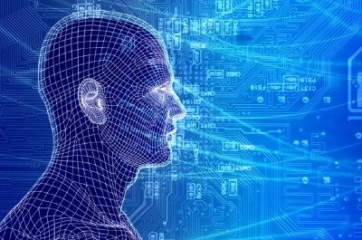
Machine Learning 101 A (Very) Brief Introduction to Machine Learning

Slide 2
Agenda
Goals for this Session
What is Machine Learning?
And how can it possibly work?
Shallow Dive Into Deep Neural Net Technology
Google PUE Use Case
Q&A

Slide 3
Goals for this Session
To cut through some of the Machine
Learning (ML) hype and give us a
basic common understanding of ML
so that we can discuss its application
to our use cases of interest.
So, remembering our architecture…

Slide 4






Software Defined Intelligence
Architecture Overview
Domain Knowledge
Domain Knowledge
Domain Knowledge
Domain Knowledge
Brocade and 3rd party Applications
Focus Here
Presentation Layer
Data Collection
Packet brokers, flow data, …
Preprocessing
Big Data, Hadoop, Data Science, …
Model Generation
Machine Learning
Oracle
Model(s)
Remediation/Optimization/…
Oracle
Logic

Slide 5
Agenda
Goals for this Session
What is Machine Learning?
And how can it possibly work?
Shallow Dive Into Deep Neural Net Technology
Google PUE Use Case
Q&A

Slide 6
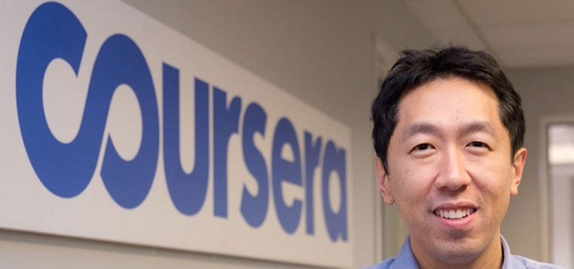
Before We Start What is the SOTA in Machine Learning?
“Building High-level Features Using Large Scale Unsupervised Learning”, Andrew Ng, et. al, 2012
http://arxiv.org/pdf/1112.6209.pdf
Training a deep neural network
Showed that it is possible to train neurons to be selective for high-level concepts using entirely unlabeled data
In particular, they trained a deep neural network that functions as detectors for faces, human bodies, and cat faces by training on random frames of YouTube videos (ImageNet¹). These neurons naturally capture complex invariances such as out-of-plane rotation, scale invariance, …
Details of the Model
Sparse deep auto-encoder (catch me later if you are interested what this is/how it works)
O(10⁹) connections
O(10⁷) 200x200 pixel images, 10³ machines, 16K cores
→ Input data in R⁴⁰⁰⁰⁰
Three days to train
15.8% accuracy categorizing 22K object classes
70% improvement over current results
Random guess achieves less than 0.005% accuracy for this dataset
Andrew Ng and his crew at Baidu have recently beat this record with their
(GPU based) Deep Speech system. See http://arxiv.org/abs/1412.5567
1 http://www.image-net.org/

Slide 7
What is Machine Learning?
The complexity in traditional computer programming is in the code (programs that people write). In machine learning, algorithms (programs) are in principle simple and the complexity (structure) is in the data. Is there a way that we can automatically learn that structure? That is what is at the heart of machine learning.
-- Andrew Ng
That is, machine learning is the about the construction and study
of systems that can learn from data. This is very different than
traditional computer programming.

Slide 8
The Same Thing Said in Cartoon Form
Traditional Programming
Machine Learning
Data
Computer
Output
Program
Data
Computer
Program
Output

Slide 9
When Would We Use Machine Learning?
When patterns exists in our data
Even if we don’t know what they are
Or perhaps especially when we don’t know what they are
We can not pin down the functional relationships mathematically
Else we would just code up the algorithm
When we have lots of (unlabeled) data
Labeled training sets harder to come by
Data is of high-dimension
High dimension “features”
For example, sensor data
Want to “discover” lower-dimension representations
Dimension reduction
Aside: Machine Learning is heavily focused on implementability
Frequently using well know numerical optimization techniques
Lots of open source code available
See e.g., libsvm (Support Vector Machines): http://www.csie.ntu.edu.tw/~cjlin/libsvm/
Most of my code in python: http://scikit-learn.org/stable/ (many others)
Languages (e.g., octave: https://www.gnu.org/software/octave/)

Slide 10
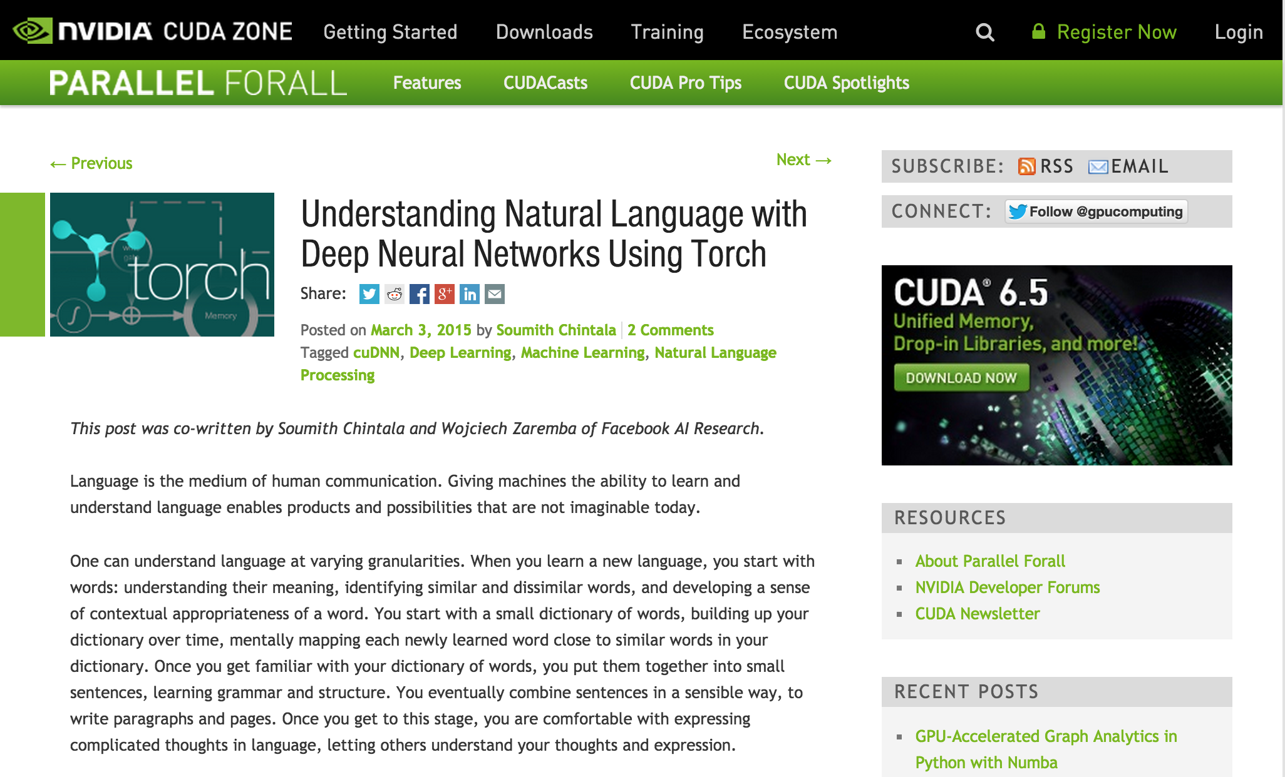
Aside: NVIDA

Slide 11
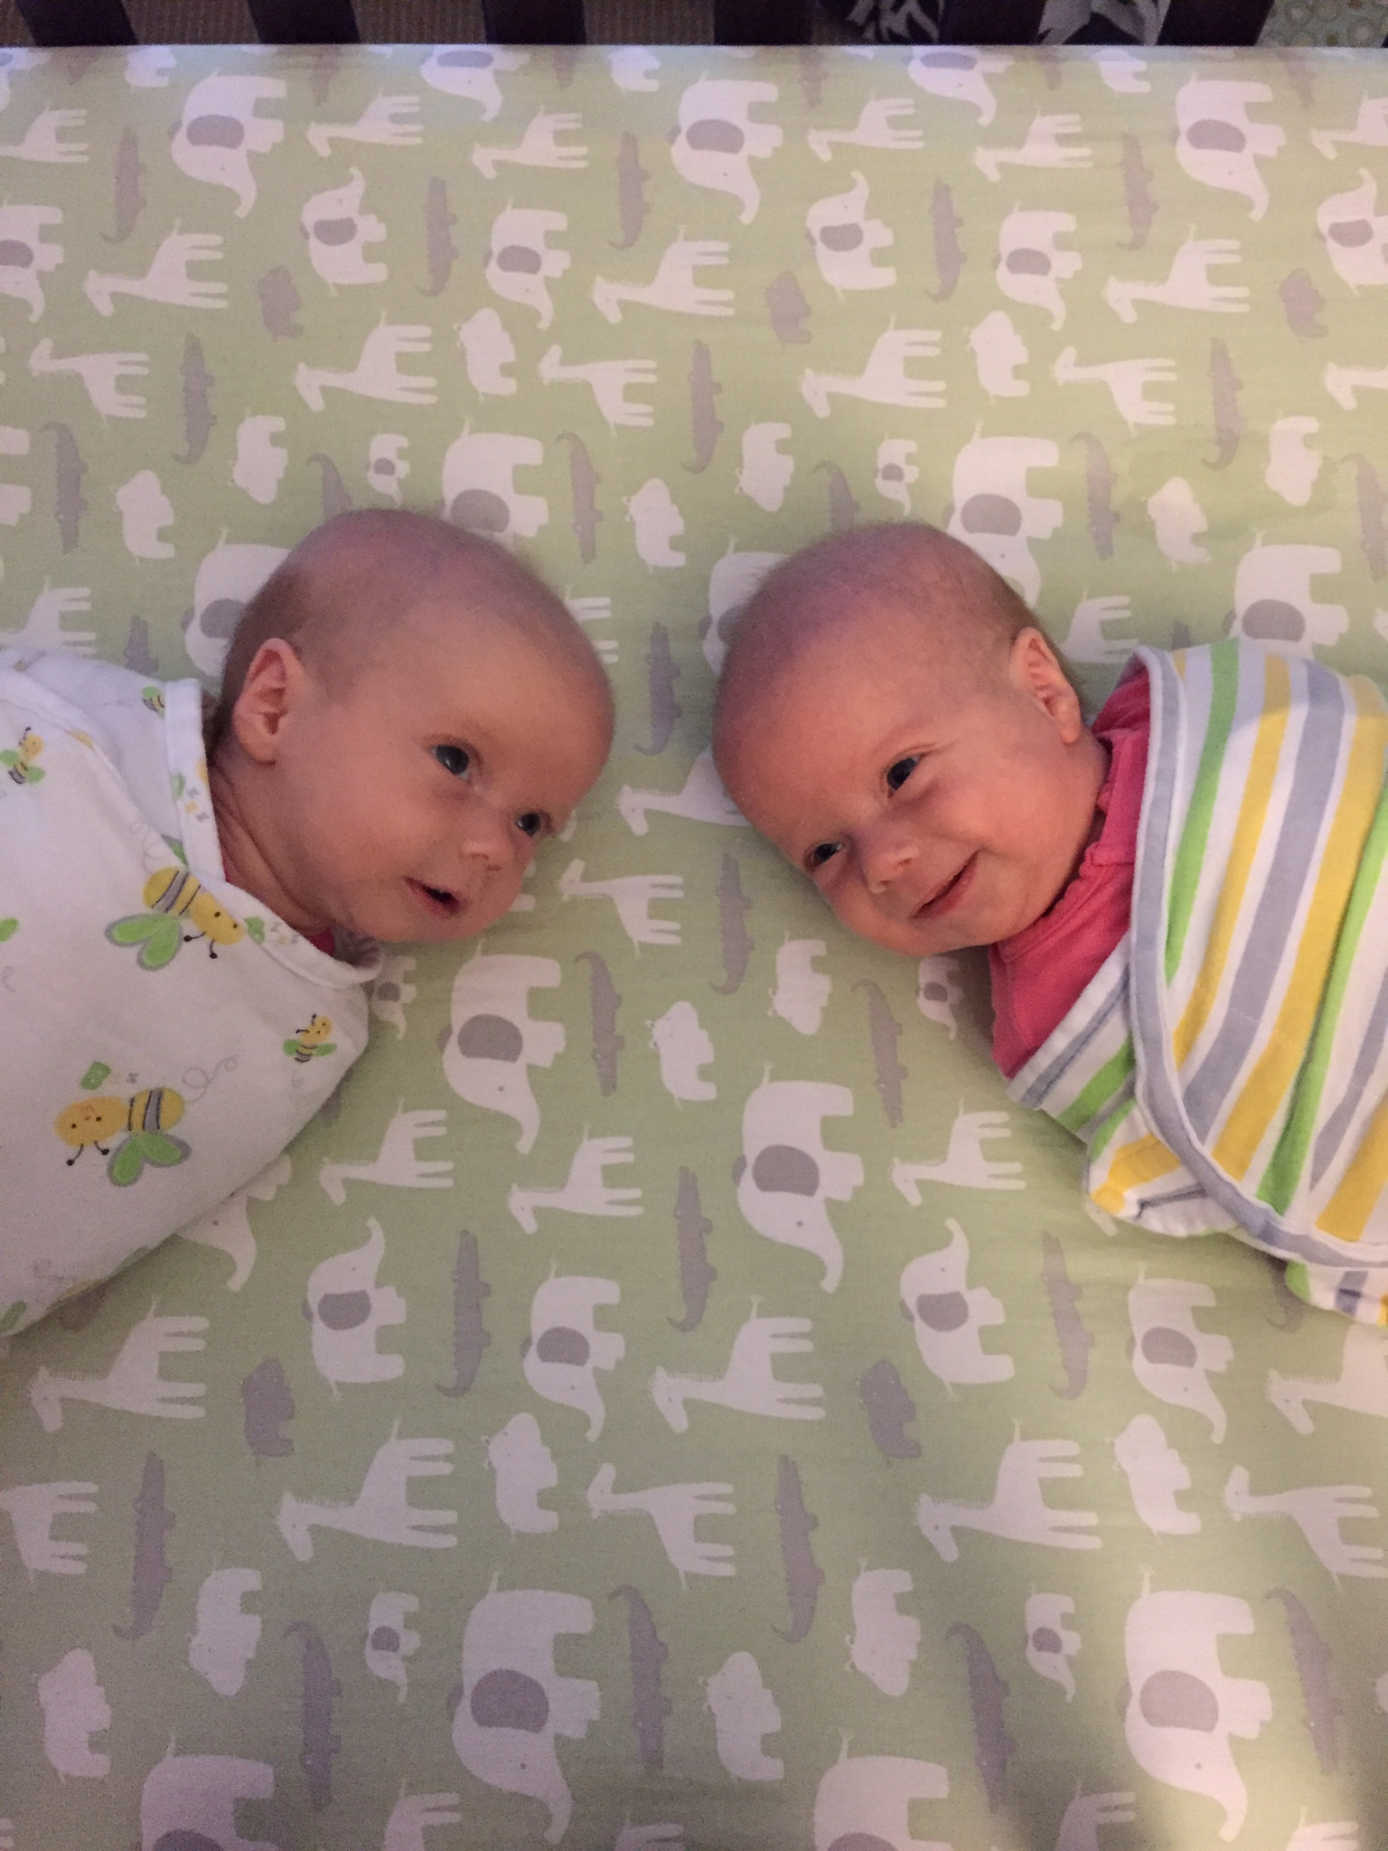
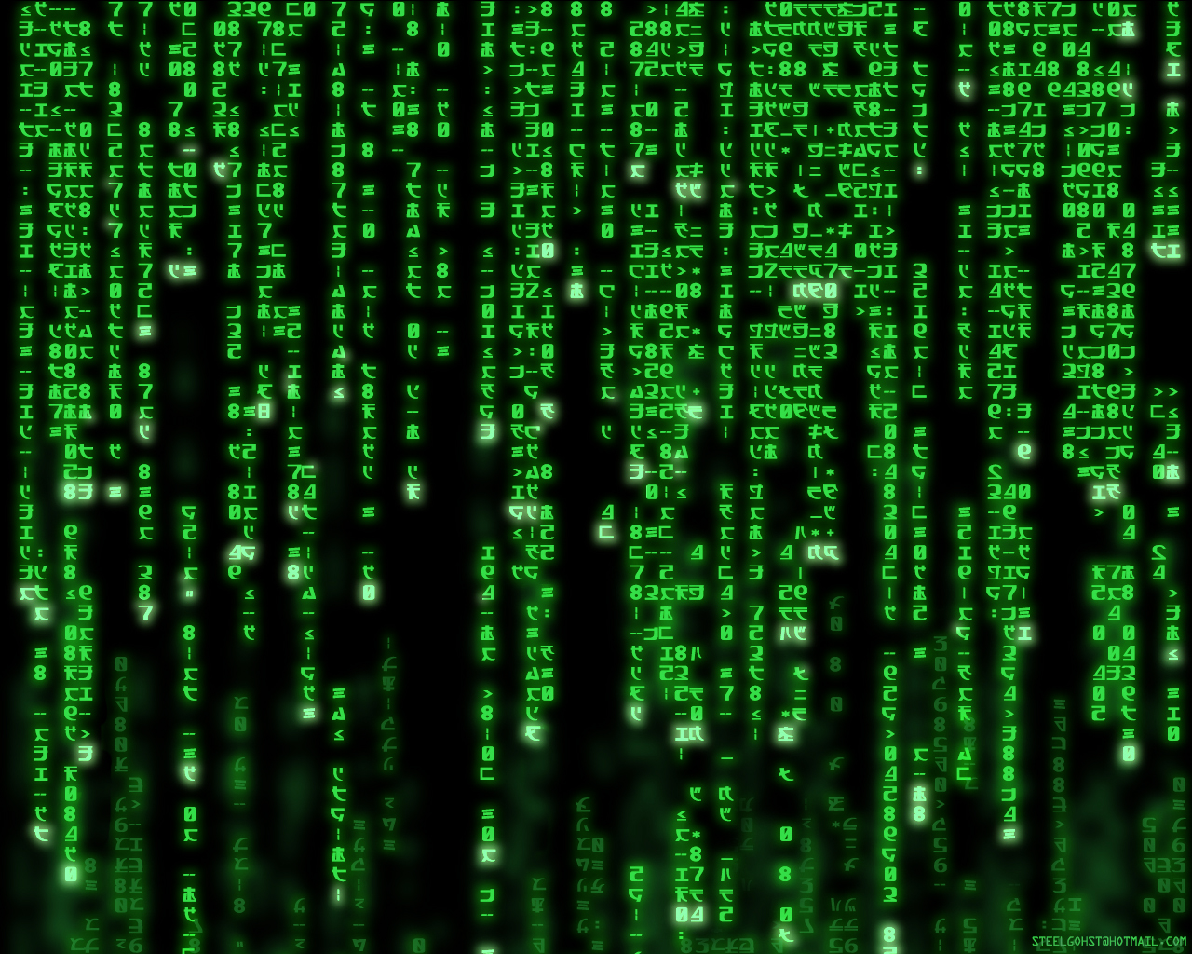
Why Machine Learning is Hard?
Your ML Algorithm Sees
A Bunch of Bits
You See

Slide 12
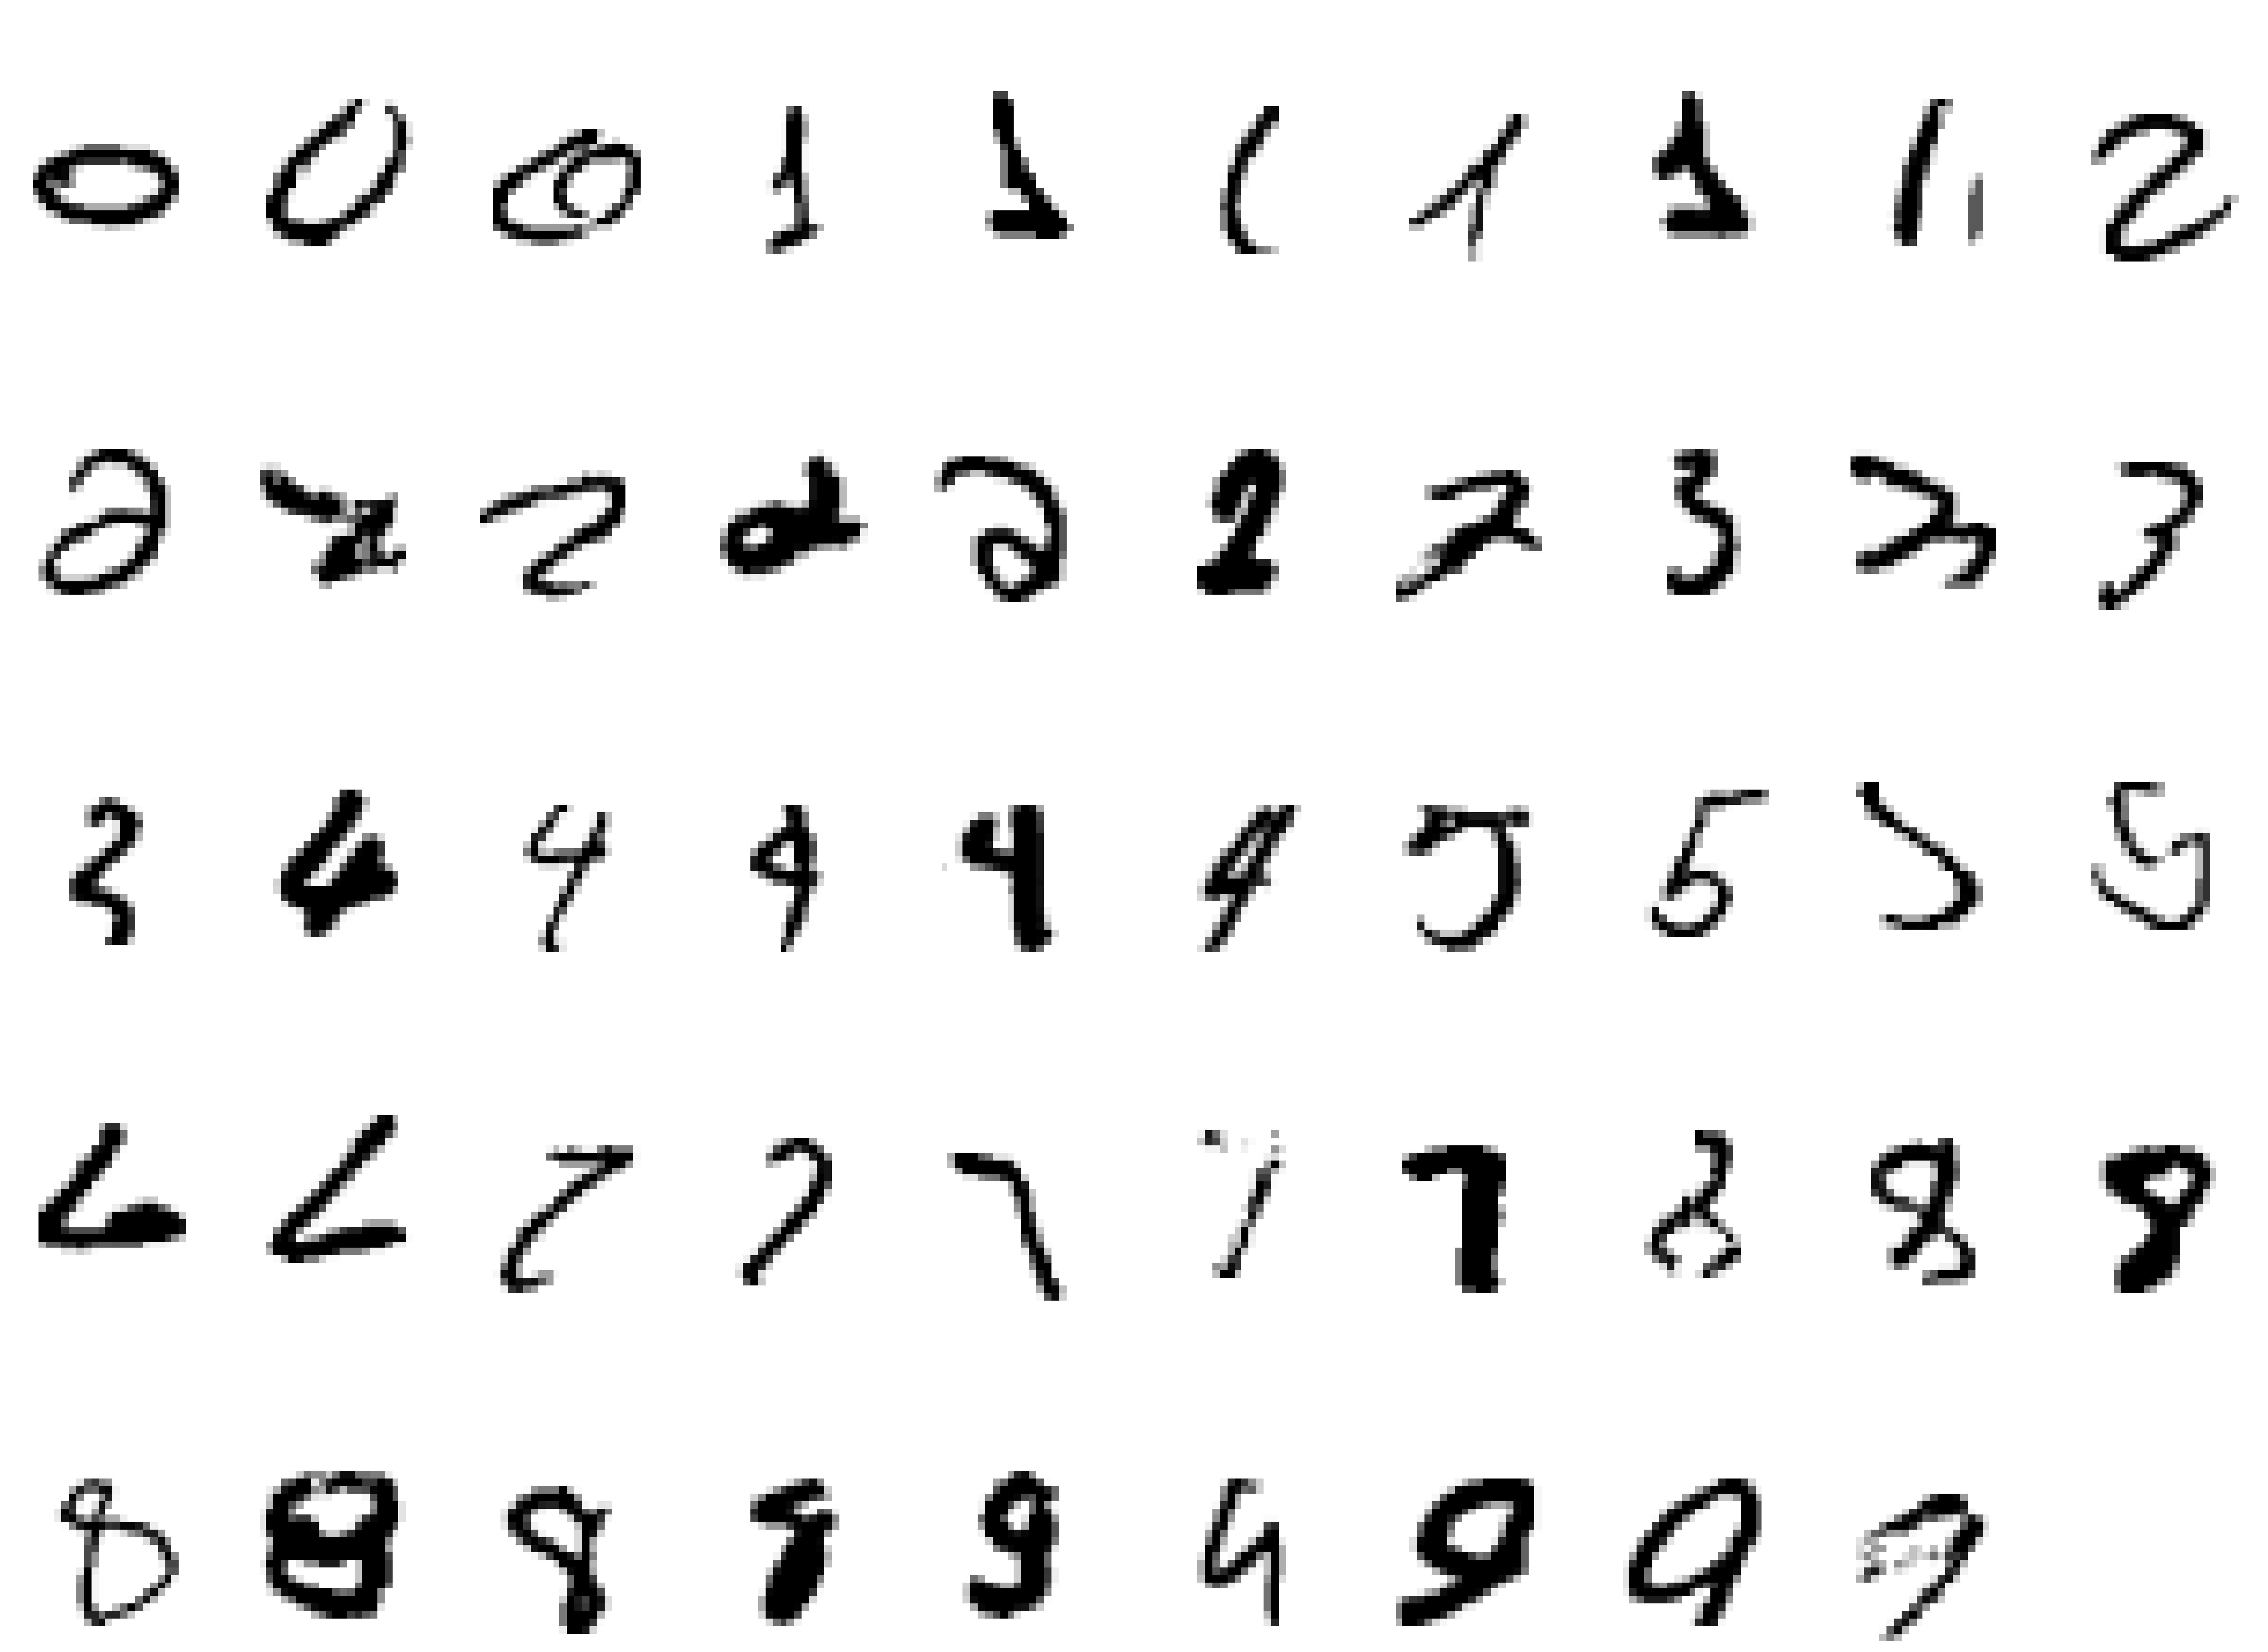
Why Machine Learning Is Hard, Redux What is a “2”?

Slide 13
Examples of Machine Learning Problems
Pattern Recognition
Facial identities or facial expressions
Handwritten or spoken words (e.g., Siri)
Medical images
Sensor Data/IoT
Optimization
Many parameters have “hidden” relationships that can be the basis of optimization
Pattern Generation
Generating images or motion sequences
Anomaly Detection
Unusual patterns in the telemetry from physical and/or virtual plants (e.g., data centers)
Unusual sequences of credit card transactions
Unusual patterns of sensor data from a nuclear power plant
or unusual sound in your car engine or …
Prediction
Future stock prices or currency exchange rates
Network events
…

Slide 14
Finally, note that ML is a form of Induction
Given examples of a function (x, f(x))
Don’t explicitly know f
Rather, trying to learn f from the data
Labeled training data set (i.e., the f(x)’s)
Training set will be noisy, e.g., (x, (f(x) + ε))
Notation: (x_{i}, f(x_{i})) denoted (x^{(i)},y^{(i)})
y^{(i)} sometimes called t_{i} (t for “target”)
Predict function f(x) for new examples x
Discrimination/Prediction (Regression): f(x) continuous
Classification: f(x) discrete
Estimation: f(x) = P(Y = c|x) for some class c

Slide 15
Agenda
Goals for this Session
What is Machine Learning?
And how can it possibly work?
Shallow Dive Into Deep Neural Net Technology
Google PUE Use Case
Q&A

Slide 16
How Can Machine Learning Possibly Work?
We want to build statistical models that generalize to unseen cases
What assumptions do we need to do this (essentially predict the future)?
4 main “prior” assumptions are (at least) required
Smoothness
Manifold Hypothesis
Distributed Representation/Compositionality
Compositionality is useful to describe the world around us efficiently → distributed representations (features) are meaningful by themselves.
Non-distributed → # of distinguishable regions linear in # of parameters
Distributed → # of distinguishable regions grows almost exponentially in # of parameters
Each parameter influences many regions, not just local neighbors
Want to generalize non-locally to never-seen regions → essentially exponential gain
Shared Underlying Explanatory Factors
The assumption here is that there are shared underlying explanatory factors, in particular between p(x) (prior distribution) and p(Y|x) (posterior distribution). Disentangling these factors is in part what machine learning is about.
Before this, however: What is the problem in the first place?

Slide 17
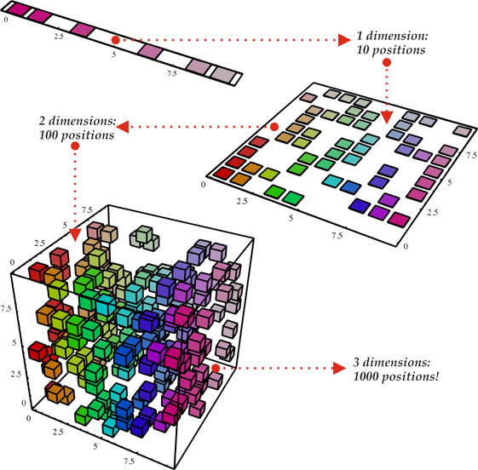
Why ML Is Hard The Curse Of Dimensionality
To generalize locally, you need representative examples from all relevant variations (and there are an exponential number of them)!
Classical Solution: Hope for a smooth enough target function, or make it smooth by handcrafting good features or kernels
Smooth?
(i). Space grows exponentially
(ii). Space is stretched, points
become equidistant

Slide 18
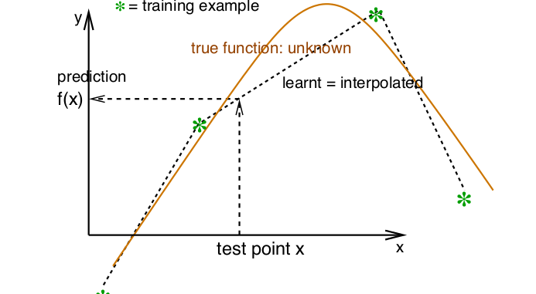
So What Is Smoothness?
Smoothness → If x is geometrically close to x’ then f(x) ≈ f(x’)

Slide 19
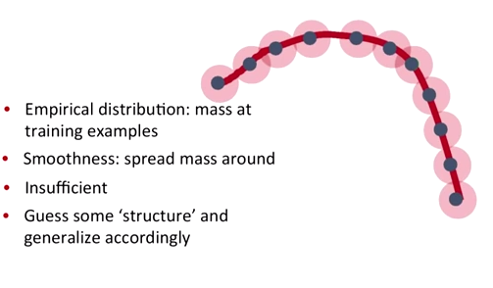
Smoothness, basically…
Probability mass P(Y=c|X;θ)
This is where the Manifold Hypothesis comes in…

Slide 20
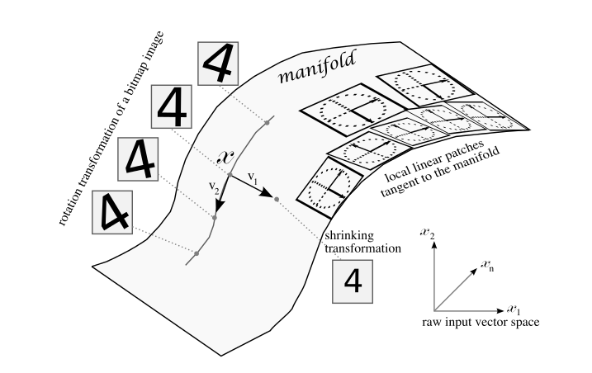
Manifold Hypothesis
BTW, you can demonstrate the MH to yourself
with a simple thought experiment on image data…
The Manifold Hypothesis states that natural data forms lower dimensional manifolds
in its embedding space. Why should this be? Well, it seems that there are both
theoretical and experimental reasons to suspect that the Manifold Hypothesis is true.
So if you believe that the MH is true, then the task of a machine learning classification
algorithm is fundamentally to separate a bunch of tangled up manifolds.

Slide 21
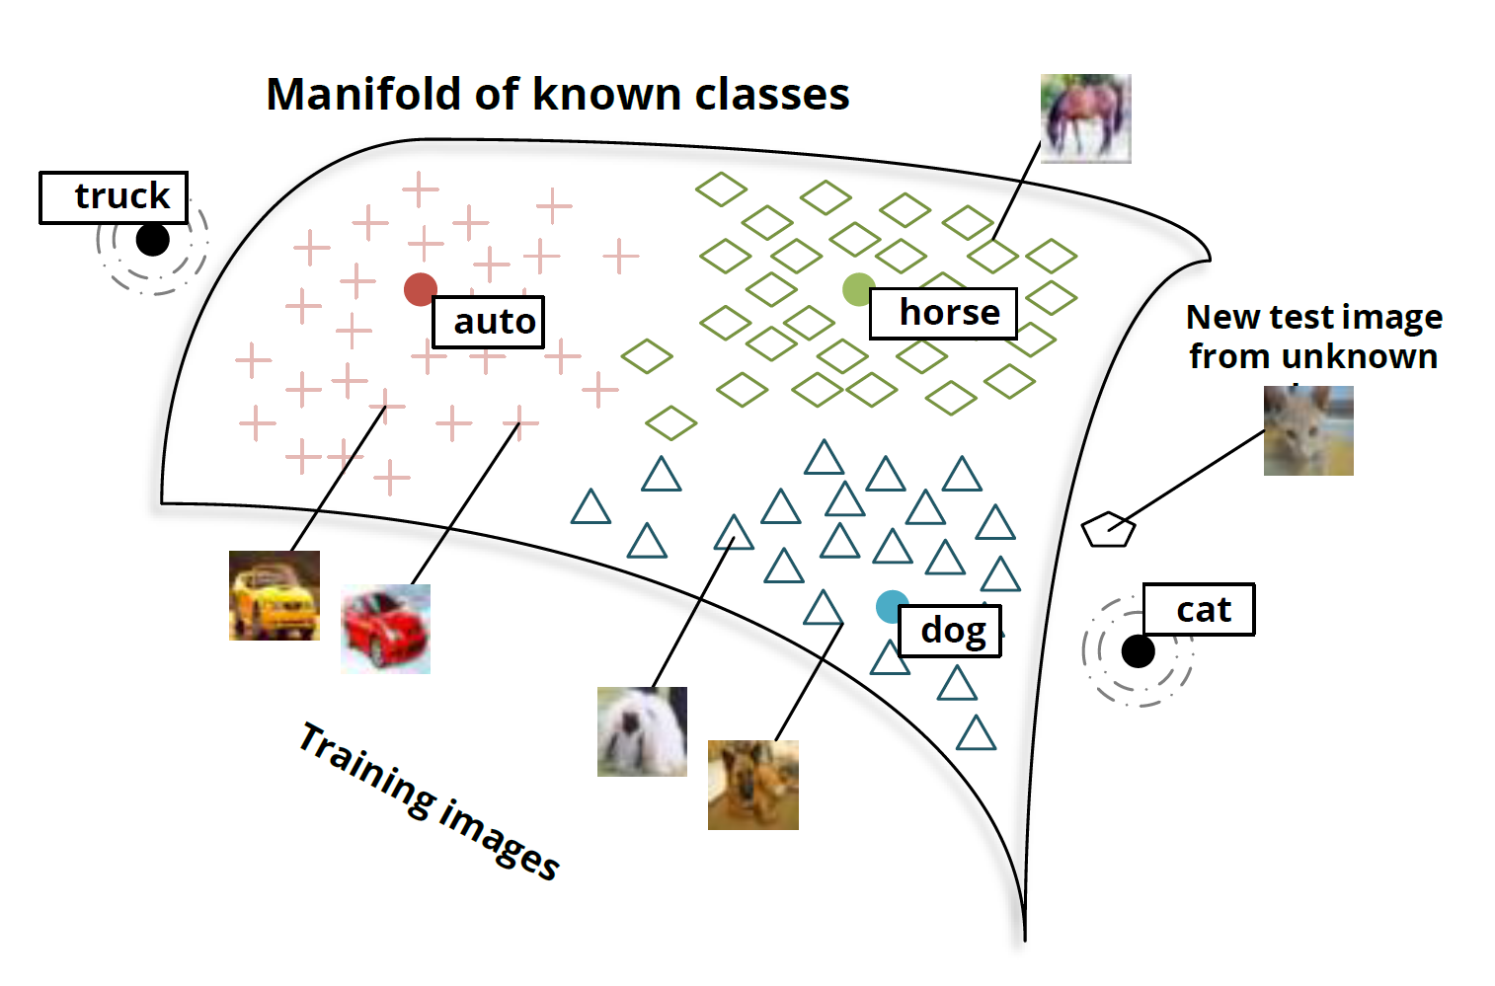
Another View: Manifolds and Classes

Slide 22
Ok, Great. What Then Is Learning?
Learning is a procedure that consists of estimating the model parameters so that the learned model (algorithm) can perform a specific task
In Artificial Neural Networks, these parameters are the weight matrix (w_{i,j}’s)
2 types of learning considered here
Supervised
Unsupervised
Semi-supervised learning
Reinforcement learning
Supervised learning
Present the algorithm with a set of inputs and their corresponding outputs
See how closely the actual outputs match the desired ones
Note generalization error (bias, variance)
Iteratively modify the parameters to better approximate the desired outputs (gradient descent)
Unsupervised
Algorithm learns internal representations and important features
So let’s take a closer look at these learning types

Slide 23
Supervised learning
The desired response (function) of given inputs is well known
You are given the “answer” (label) in the training set
Training data is set of (x^{(i)},y^{(i)}) pairs, x^{(i)} is the input example, y^{(i)} is the label
There are many 10s (if not 100s or 1000s) of supervised learning learning algorithms
These include: Artificial Neural Networks, Decision Trees, Ensembles (Bagging, Boosting, Random Forests, …), k-NN, Linear Regression, Naive Bayes, Logistic Regression (and other CRFs), Support Vector Machines (and other Large Margin Classifiers), …
Focus on Artificial Neural Networks (ANNs) here
The Google Data Center PUE example we will look at later uses supervised learning on a deep neural network

Slide 24
Unsupervised learning
Basic idea: Discover unknown structure in input data
Data clustering and dimension reduction
More generally: find the relationships/structure in the data set
No need for labeled data
The network itself finds the correlations in the data
Learning algorithms include (again, many algorithms)
K-Means Clustering
Auto-encoders/deep neural networks
Restricted Boltzmann Machines
Hopfield Networks
Sparse Encoders
…

Slide 25
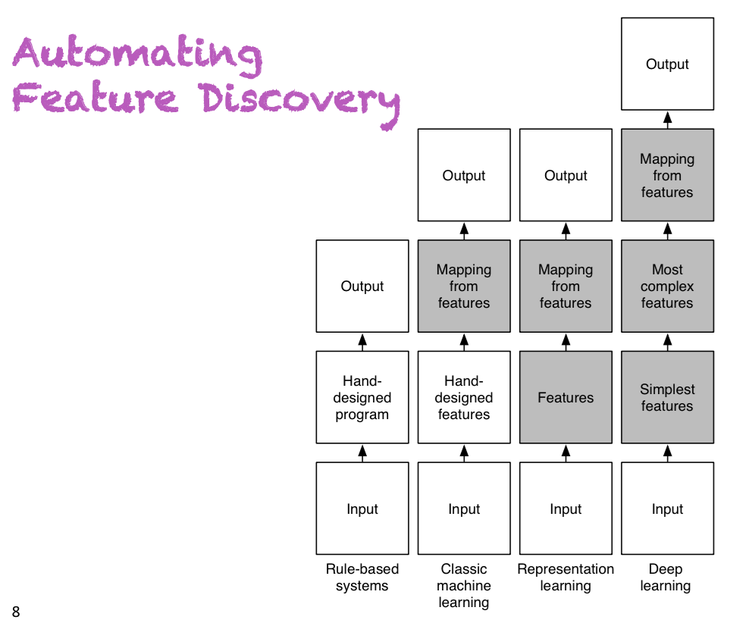
Taxonomy of Learning Techniques
Slide courtesy Yoshua Bengio

Slide 26
Artificial Neural Networks
A Bit of History
Biological Inspiration
Artificial Neurons (AN)
Artificial Neural Networks (ANN)
Computational Power of Single AN
Computational Power of an ANN
Training an ANN -- Learning

Slide 27
Brief History of Neural Networks
1943: McCulloch & Pitts show that neurons can be combined to construct a Turing machine (using ANDs, ORs, & NOTs)
1958: Rosenblatt shows that perceptrons will converge if what they are trying to learn can be represented
1969: Minsky & Papert showed the limitations of perceptrons, killing research for a decade
1985: The backpropagation algorithm revitalizes the field
Geoff Hinton et al
2006: The Hinton lab solves the training problem for DNNs

Slide 28
Biological Inspiration: Neurons
A neuron has
Branching input (dendrites)
Branching output (the axon)
Information moves from the dendrites to the axon via the cell body
Axon connects to dendrites via synapses
Synapses vary in strength
Synapses may be excitatory or inhibitory

Slide 29
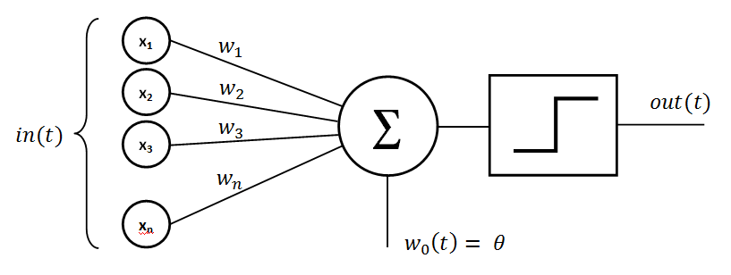
Basic Perceptron (Rosenblatt, 1950s and early 60s)
What was the problem
here?

Slide 30
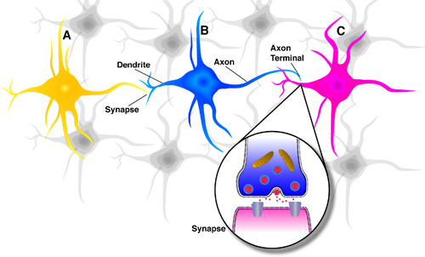
What is an Artificial Neuron?
An Artificial Neuron (AN) is a non-linear parameterized function with restricted output range
y
b
w₁
w₂
w₃
x1
x2
x3
Lets blow this up a bit
Spike-Timing Dependent Plasticity (STDP)
http://en.wikipedia.org/wiki/Hebbian_theory

Slide 31
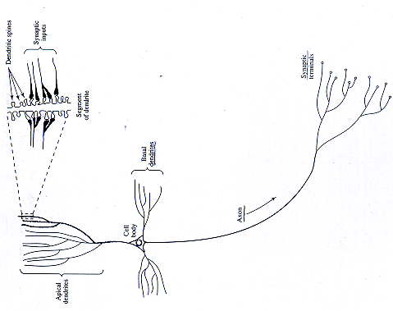
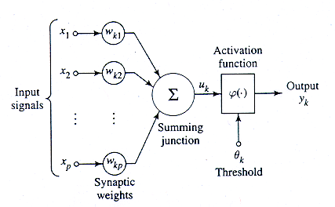
Mapping to Biological Neurons
Dendrite
Cell Body
Axon

Slide 32
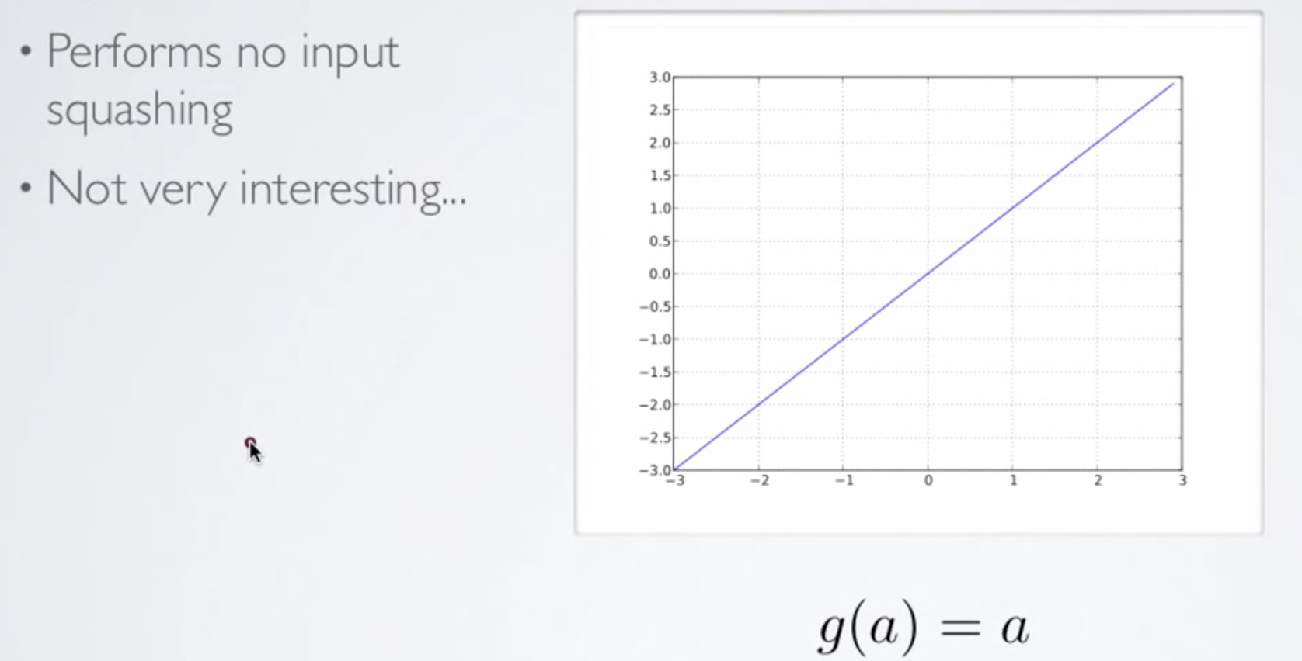
Activation Functions – Linear Function

Slide 33
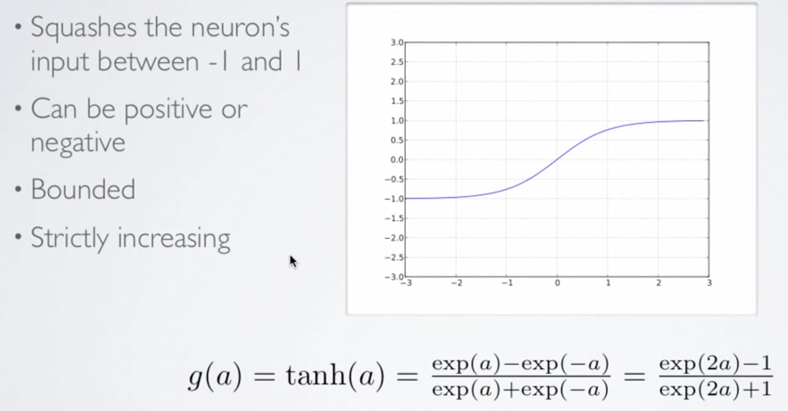
Activation Functions – Hyperbolic Tangent

Slide 34
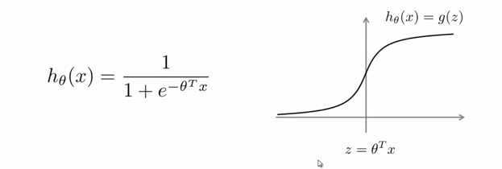
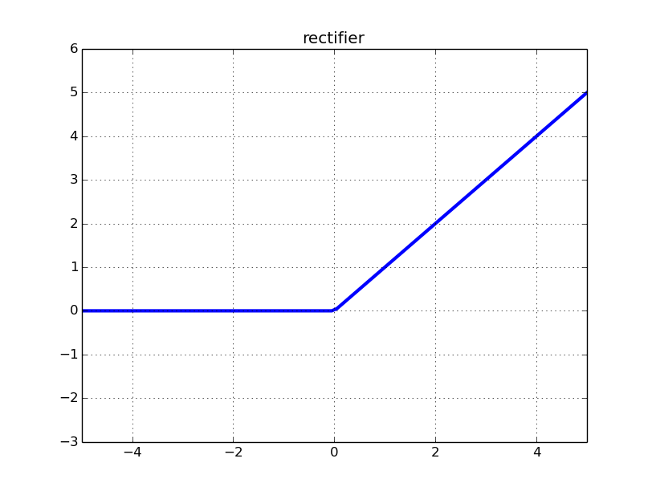
Activation Functions – Sigmoid Function
Recent successes (e.g., Baidu Deep Speech) use
(clipped) Rectifier Linear Units:
f(x) = max(0,x) -- rectifier
f(x) = min(max(0,x), clip)
Smooth approximation (softplus):
Squashes the input (x) onto the open interval [0,1]

Slide 35
Summary: Artificial neurons
An Artificial Neuron is a non-linear parameterized function with restricted output range
y
w0
w₀ also called a bias term (b_{i})
x1
x2
x3

Slide 36
Ok, Then What is an Artificial Neural Network (ANN)?
An ANN is mathematical model designed to solve engineering problems
Group of highly connected artificial neurons to realize compositions of non-linear functions (usually one of the ones we just looked at)
Tasks
Classification
Discrimination
Estimation
2 main types of networks
Feed forward Neural Networks
Recurrent Neural Networks

Slide 37
Feed Forward Neural Networks
The information is propagated from the inputs to the outputs
Directed Acyclic Graph (DAG)
Computes one or more non-linear functions
Computation is carried out by composition of some number of algebraic functions implemented by the connections, weights and biases of the hidden and output layers
Hidden layers compute intermediate representations
Dimension reduction
Time has no role -- no cycles between outputs and inputs
Output layer
2nd hidden
layer
1st hidden
layer
x₁
x₂
…..
x_{n}
We say that the input data, or features, are n dimensional

Slide 38
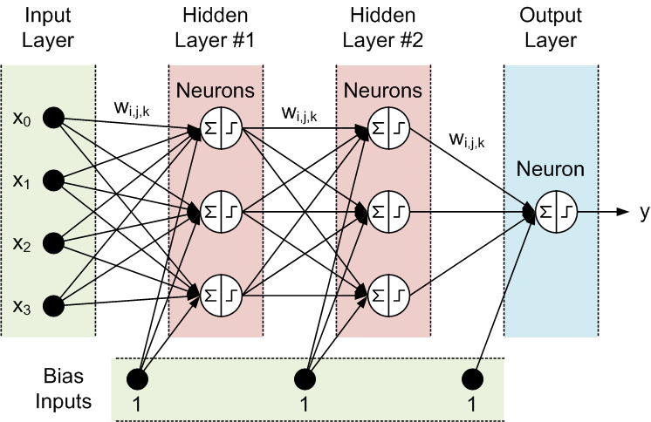
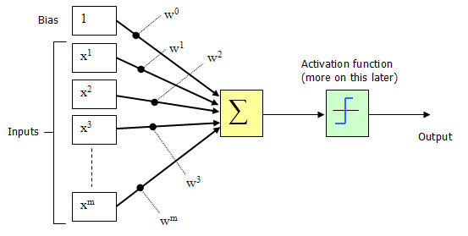
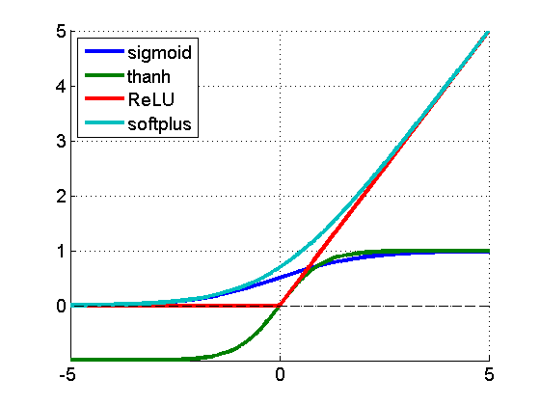
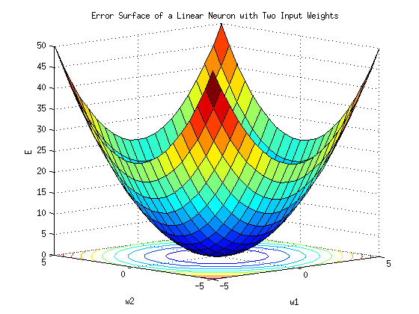
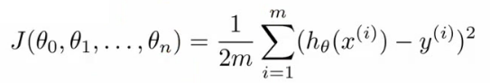
Deep Feed Forward Neural Nets (in 1 Slide (☺))
(x^{(i)},y^{(i)})
h_{θ}(x^{(i)})
Where do the weights come from?
hypothesis
Forward Propagation
So what then is learning?
Learning is the adjusting of the weights w_{i,j} such that
the cost function J(θ) is minimized (a form of Hebbian
learning).
Simple learning procedure: Back Propagation (of the error signal)

Slide 39
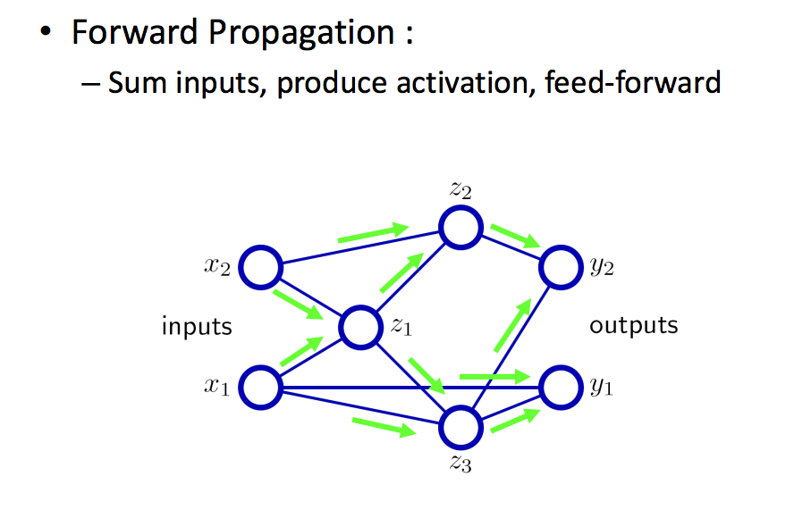
Forward Propagation Cartoon

Slide 40
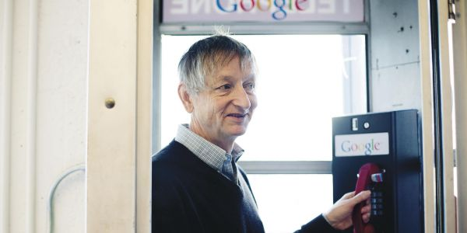
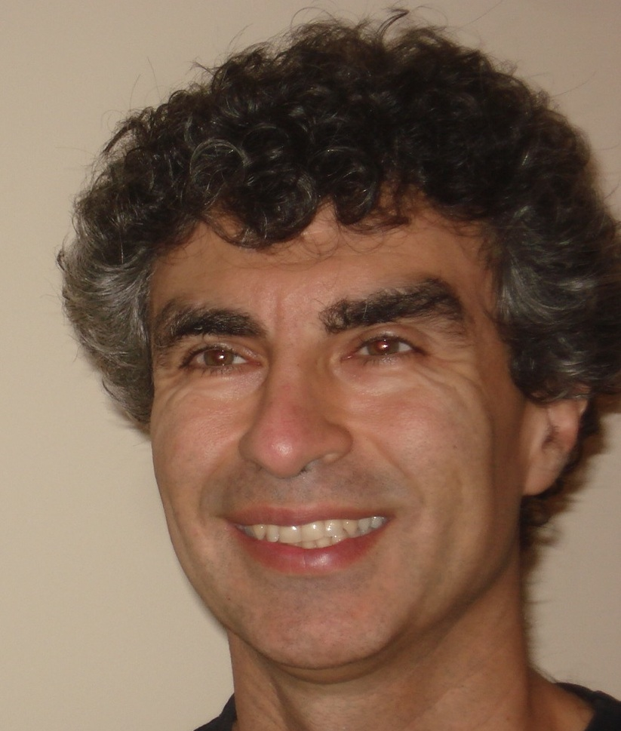
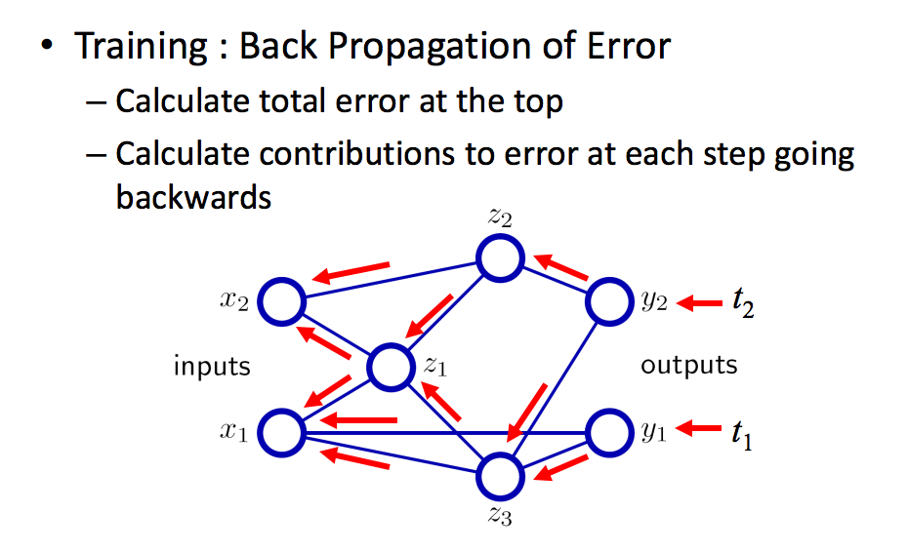

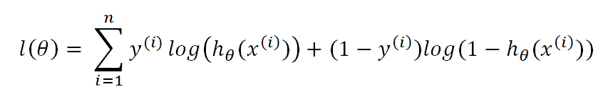
Back propagation Cartoon
http://chronicle.com/article/The-Believers/190147

Slide 41
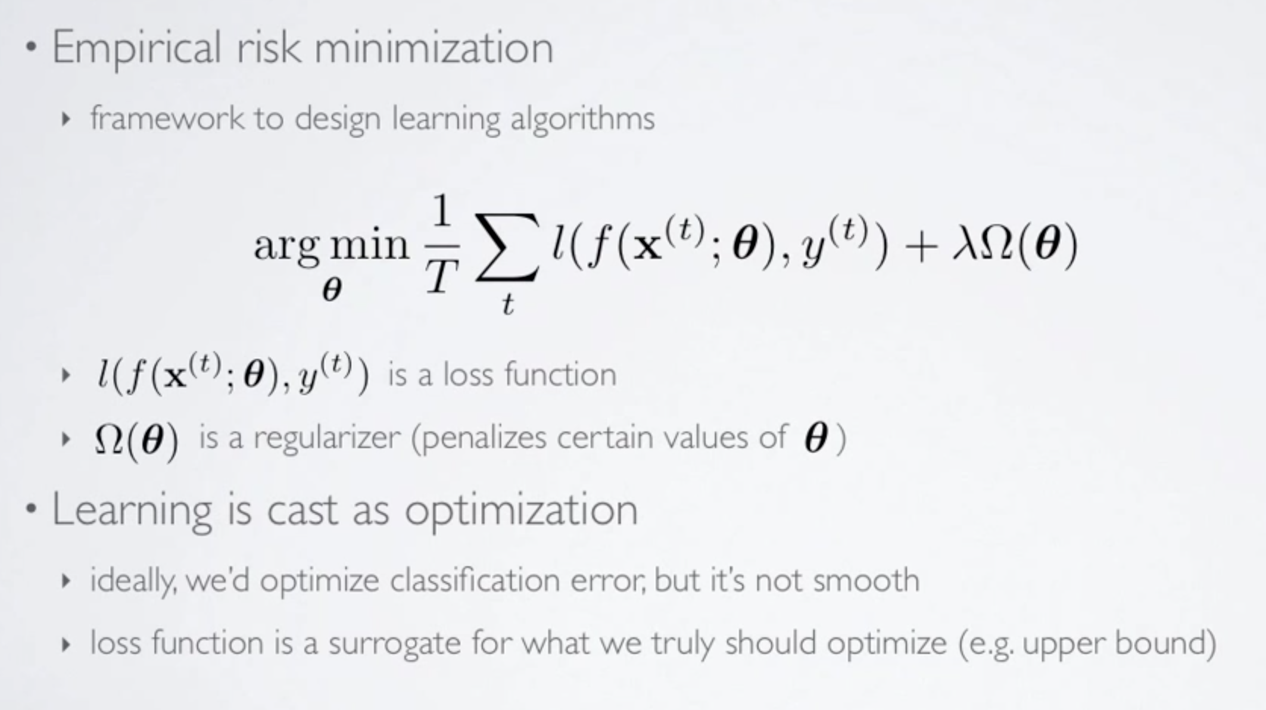
More Formally Empirical Risk Minimization
(loss function also called “cost function” denoted J(θ))
Any interesting cost function is complicated and non-convex

Slide 42
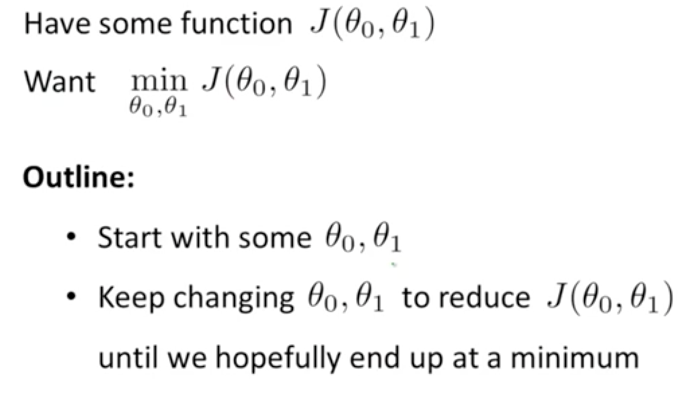
Solving the Risk (Cost) Minimization Problem Gradient Descent – Basic Idea

Slide 43
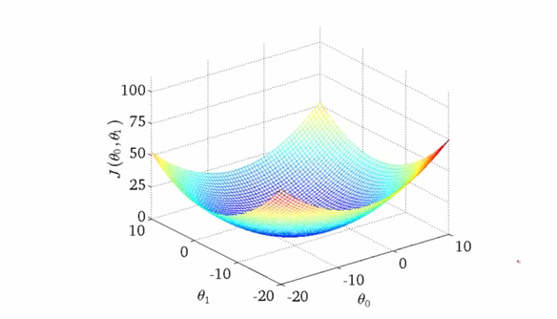
Gradient Descent Intuition 1 Convex Cost Function
One of the many nice properties of
convexity is that any local minimum
is also a global minimum

Slide 44
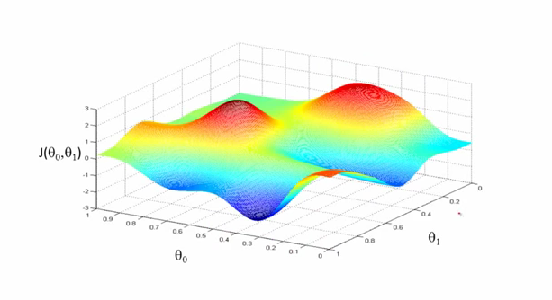
Gradient Decent Intuition 2
Can get stuck here if unlucky/start
at the wrong place
Unfortunately, any interesting cost function is likely non-convex

Slide 45
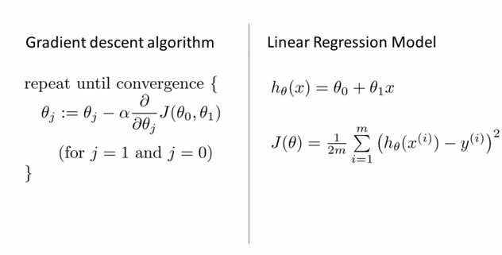
Solving the Optimization Problem Gradient Descent for Linear Regression
The big breakthrough came from the Hinton lab at UToronto in the mid 80’s where
the back propagation algorithm was discovered (or perhaps re-discovered). “Backprop”
is a simple way of computing the gradient of the loss function with respect to the model
parameters θ

Slide 46
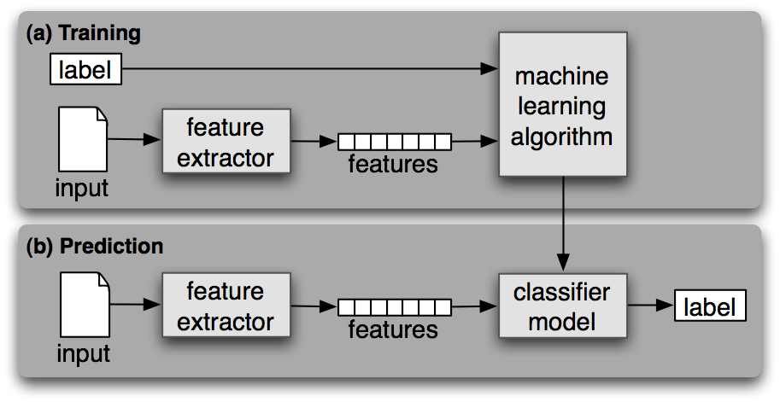
Summary: Supervised Learning Process

Slide 47
Making this Real (what do we have to do?)
Choose the labels of interest
What are the classes of interest, what might we want to classify/compute/predict?
Get the data sets (this is always the “trick”)
Labeling?
Split into training, test, cross-validation
Avoid generalization error (bias, variance)
Avoid data leakage
Choose a model
I would try supervised DNN
Extremely powerful model
We want to find “non-obvious” features, which likely live in high-dimensional space
Write code
Then write more code
Test on (previously) unseen examples
Iterate

Slide 48
Issues/Challenges
Is there a unique model that we can use?
Unlikely → online learning
Ensemble learning, among others
Network data is non-perceptual (we think)
Does the Manifold Hypothesis hold for non-perceptual data sets?
Seems to (Google PUE, etc)
Unlabeled vs. Labeled Data
Most commercial successes in ML have come with deep supervised learning → labeled data
We don’t have ready access to large labeled data sets (always a problem)
Time Series Data
With the exception of Recurrent Neural Networks, most ANNs do not explicitly model time (e.g., Deep Neural Networks)
Flow data/sampling
Training vs. {prediction,classification} Complexity
Stochastic (online) vs. Batch vs. Mini-batch
Where are the computational bottlenecks, and how do those interact with (quasi) real time requirements?

Slide 49
Agenda
Goals for this Session
What is Machine Learning?
And how can it possibly work?
Shallow Dive Into Deep Neural Net Technology
Google PUE Use Case
Q&A

Slide 50
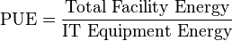
Google PUE Optimization Application¹
Straightforward application of ANN/supervised learning
Lots more happening at Google (and FB, Baidu, NFLX, MSFT,AMZN,…)
http://research.google.com/pubs/ArtificialIntelligenceandMachineLearning.html
Use case: Predicting Power Usage Effectiveness (PUE)
Basically: They developed a neural network framework that learns from operational data and models plant performance
The model is able to predict PUE² within a range of 0.004 + 0.005 , or 0.4% error for a PUE of 1.1.
“A simplified version of what the models do: take a bunch of data, find the hidden interactions, then provide recommendations that optimize for energy efficiency.”
http://googleblog.blogspot.com/2014/05/better-data-centers-through-machine.html
1 https://docs.google.com/a/google.com/viewer?url=www.google.com/about/datacenters/efficiency/internal/assets/machine-learning-applicationsfor-datacenter-optimization-finalv2.pdf
2 http://en.wikipedia.org/wiki/Power_usage_effectiveness

Slide 51
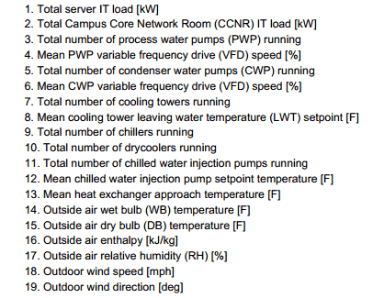
Google Use Case: Features
Number of features relatively small (n = 19)

Slide 52
Google Use Case: Algorithm
Randomly initialize the model parameters θ
Implement forward propagation
Compute the cost function J(θ)
Implement the back propagation algorithm
Repeat steps 2-4 until convergence
or for the desired number of iterations
Very standard…

Slide 53
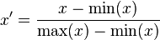
Google Use Case: Details
Neural Network
5 hidden layers
50 nodes per hidden layer
0.001 as the regularization parameter (λ)
Training Dataset
19 normalized input parameters (features) per normalized output variable (the DC PUE)
Data normalized into the range [-1,-1]
184,435 time samples at 5 minute resolution
O(2) years of data
70% for training, 30% for cross validation

Slide 54
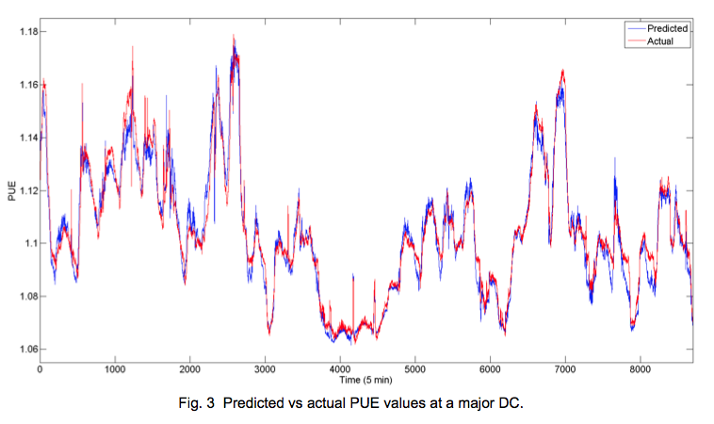
Google Use Case: PUE Predictive Accuracy
Mean absolute error: 0.004
Standard deviation: 0.005
Increased error for PUE > 1.14 due
to lack of training data

Slide 55
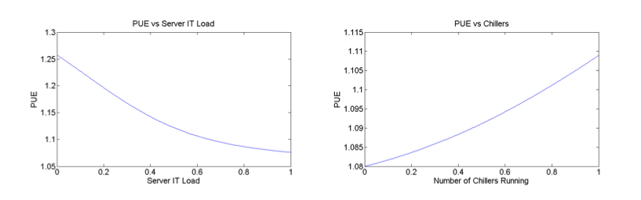
Google Use Case: Sensitivity Analysis
After the model is trained, one can look at effect of individual parameters by varying one while holding the others constant
The relationship between PUE and the number of chillers
running is nonlinear because chiller efficiency decreases
exponentially with reduced load.

Slide 56
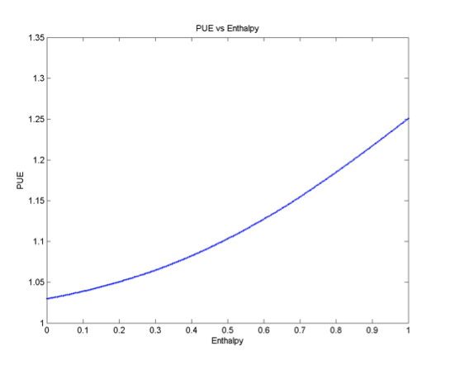
Google: Outside air enthalpy has largest impact on PUE
Relationship between PUE and outside air enthalpy, or total energy content
of the ambient air. As the air enthalpy increases, the number of cooling towers,
supplemental chillers, and associated loading rises as well, producing a nonlinear
effect on the DC overhead. Note that enthalpy is a more comprehensive measure
of outdoor weather conditions than the wet bulb temperature alone since it
includes the moisture content and specific heat of ambient air.

Slide 57
Agenda
Goals for this Session
What is Machine Learning?
And how can it possibly work?
Shallow Dive Into Deep Neural Net Technology
Google PUE Use Case
Q&A

Slide 58
Q & A
Thanks!

